Slide 1
Review of: “Genome-wide transcriptional analysis of T cell activation reveals differential gene expression associated with psoriasis”
Sam Brown, Wayne Kunze, Caleb Perry
EECS 6690, Spring 2018

Slide 2
Recreation of Results
The paper, “Genome-wide transcriptional analysis of T cell activation reveals differential gene expression associated with psoriasis” looks at T cell gene expression rates from 24 patients.
The data is openly available
Psoriasis is a common autoimmune disease, where T cells target healthy skin cells
The paper found the fold increase (or decrease) of patients with psoriasis compared to those who did not have it
The paper preprocessed the data by eliminating genes which were expressed in fewer than 3 patients. Then the algorithm of the data was found.
Reproduction of the paper’s results were mixed. Some of our methods did identify the genes the paper highlighted and others were less successful.
2 | EECS 6690

Slide 3
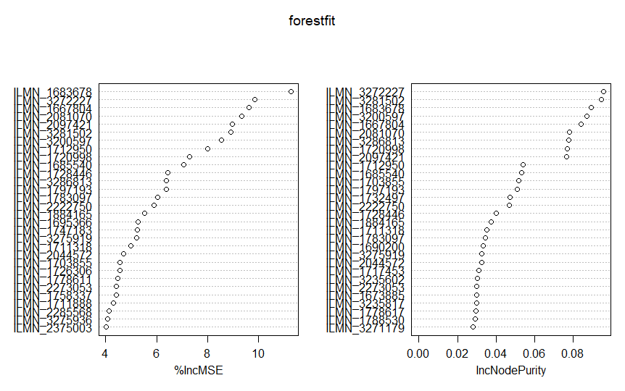
Random Forests
Implementation:
Computationally intensive – initial development required several hours to run
Large number of factors (more than 48000) requires factor reduction (not reducing factors crashes RStudio)
We subdivided the factors into “factor subsets” to identify “more important” factors that then competed to “most important factors”
3 | EECS 6690

Slide 4
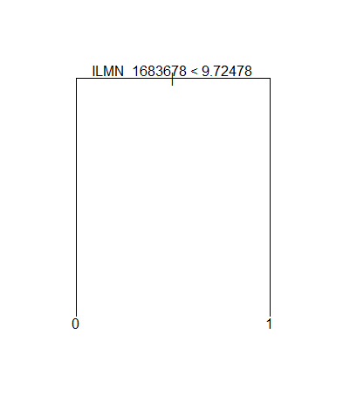
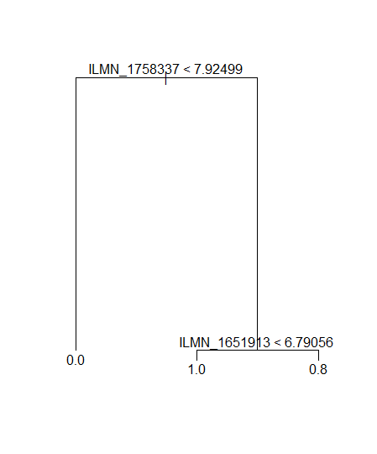
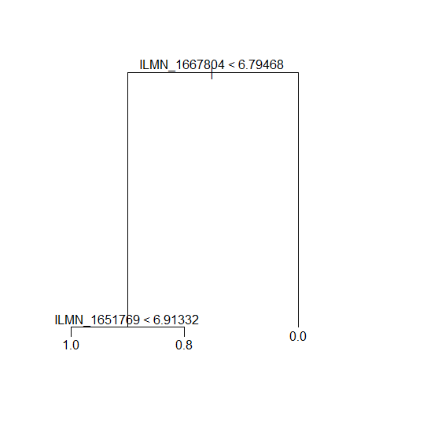
Random Forests
Results:
Very limited overlap between Random Forest analysis and other methods
ILMN_1683678 (“SPATS2L”) is identified as “most important” factor (single factor with 100% predictive accuracy)
Other trees use two factors for 96% accuracy
4 | EECS 6690

Slide 5
Dimension Reduction and Regulation
High Dimensional Model:
Patients (N) = 24, Genes (P) = 47222, P is three orders of magnitude larger than N
Can’t use standard regression techniques when p >> N
“Gene Modules”
Many genes are expressed in groups
These groups of genes are not independent
Feature reduction or shrinkage methods may be employed to reduce the model dimension
Compare the features present in the reduced models to those identified in the paper as significantly up or down regulated in Psoriasis Patients
SPATS2L
KLF6
SP140
RORA
5 | EECS 6690

Slide 6
Subset Methods
Best subset is infeasible: 2⁴⁷²²² potential models is impossible to analyze
Backward stepwise
Start with complete model
Only can be used when P < N
Forward Stepwise: O(47222 * 47222) models, large but not impossible
Start with the NULL model (y ~ 1)
Only Forward method (start with null model) works when P > N
May still need to pre-filter genes with very low variation across the 24 samples to execute
Logistic regression model appropriate to classification problem
Scoring method is AIC on the training set
6 | EECS 6690

Slide 7
Shrinkage Methods
Ridge:
Penalty for large coefficients
Doesn’t actually reduce the model dimensions
LASSO:
Minimizes RSS with a penalty for large/many coefficients
Will reduce many coefficients to 0
These features have no effect on the classification
Dependent on the magnitude of the shrinkage factor
7 | EECS 6690

Slide 8
Principal Components Analysis (PCA)
Good for reducing high dimensional data
Finds “directions” where the features vary the most
Analyze the coefficients of each principal component to determine significant genes
PVE calculation can be used to assess the “goodness” of the reduced model
8 | EECS 6690

Slide 9
Support Vector Machine (SVM)
Good for classifying data into categories
A line is created which has the greatest margin. Meaning it separates points with the greatest amount of separation
Here data was found to be linearly separable
Not surprising given the number of columns was far greater than the number of rows (many more components than data points)
Classified patients by whether they carried the disease
Using a grid search and 10 fold cross validation optimal values were found for the SVM
9 | EECS 6690

Slide 10
K Means Clustering
Kmeans clustering is a very common example of Unsupervised learning
In unsupervised learning data labels are not considered (often not available)
Kmeans attempts to group data into K groups by finding best means and the points closest to them
How distance is calculated is therefore very important. Both Manhattan and Euclidean distance were examined, however Euclidean was used.
Here data the clusters did not revolve around the presence of the disease.
At first Kmeans was attempted with 2 clusters, but then more clusters were tried. Whether a given patient had psoriasis did not contribute to the algorithm clustering the data one way or another
At larger number of clusters, there was a slight correlation, but not drastic
10 | EECS 6690

Slide 11
References
1. Palau, Julia, Ferrandiz, Puig, Fonseca, Fernadez, Lopez-Lasanta, Tortose, Marsal. "Genome-wide transcriptional analysis of T cell activation reveals differential gene expression associated with psoriasis." BMC Genomics (2013): 14:825
2. James, Witten, Hastie, Tibshirani. An Introduction to Statistical Learning with Applications in R. New York, NY: Springer, 2013. Ebook.
3. Hastie, Tibshirani, Friedman. The Elements of Statistical Learning. New York, NY: Springer, 2009. Ebook.
11 | EECS 6690

Slide 12

Questions/Comments?
12 | EECS 6690

